Slide 1

IMDB Movie Analysis
- Sheevam Chakraborty

Slide 2
Objective
The aim is to examine the IMDB Movies dataset in order to pinpoint important elements that contribute to a film's success, which is determined by its high IMDB rating. The goal of this study is to give investors, producers, and directors of motion pictures insightful information that will enable them to make better decisions and increase the probability that their next projects will succeed.

Slide 3
Approach and Tech Stack
1. Data Exploration: Open Excel and import the IMDB Movies dataset. Analyse exploratory data to determine how important variables like cast, budgets, genres, and ratings are distributed.
2. Excel functions for descriptive statistics: Use Excel functions to get descriptive statistics for pertinent variables. Find outliers, KPI and correlations that could affect the box office performance of a film.
3. Correlation Analysis: Find correlations between IMDB ratings and variables such as cast members, budget, and genre. Use Excel's basic statistical tests to find associations that are statistically significant.
4. Regression analysis: Model the association between influential factors and IMDB ratings with regression analysis. Determine the direction and strength of the relationships, offering insights into the elements that contribute to the success of the film.
5. Data Visualization and Presentation of Insights: To illustrate statistical findings, create visualizations like bar charts and scatter plots. Provide stakeholders in the film industry with actionable insights by summarizing and interpreting the statistical results.

Slide 4
Five “WHY” Approach
Q. Why does a movie get higher score/rating from viewers?
They like the movie
Q. Why do they like the movie?
It has a great storyline
Q. Why does it have a great storyline?
It is written/directed by a top director
Q. Why is it directed by a top director?
The movie had ample budget to bring in the best team
Q. Why does the best team have an impact on the viewers rating?
Due to the chemistry between the team members the viewer gets to experience
a masterpiece where it is no longer fiction but extremely close to reality.
Root
Cause
Analysis

Slide 5
Insights
Let’s get started with the questions then
We have five objectives to work on this time

Slide 6
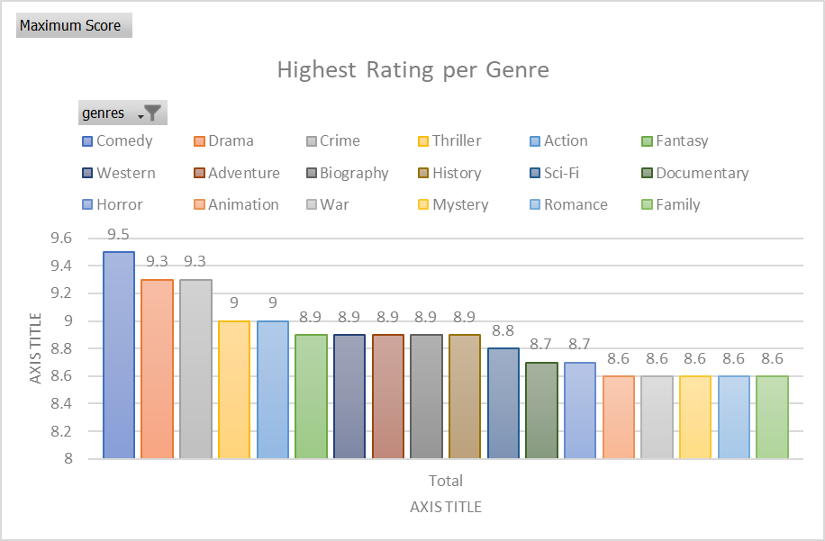
A. Movie Genre Analysis: Analyze the distribution of movie genres and their impact on the IMDB score.
Task: Determine the most common genres of movies in the dataset. Then, for each genre, calculate descriptive statistics (mean, median, mode, range, variance, standard deviation) of the IMDB scores.
MOST common genres
Comedy has the highest score among genres
9.5
The most common genre with highest number of movies is Drama
2506

Slide 7
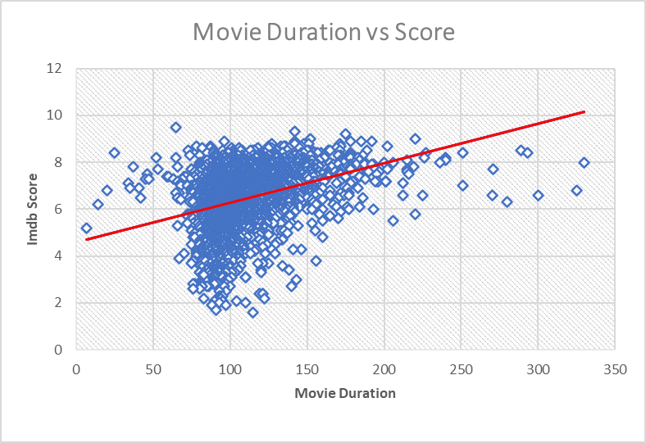
B. Movie Duration Analysis: Analyze the distribution of movie durations and its impact on the IMDB score.
Task: Analyze the distribution of movie durations and identify the relationship between movie duration and IMDB score.
Long movies have the highest ratings among viewers
7.8
Majority of the viewers enjoy movies with duration 110 – 140 minutes overall.
Linear Trendline supports this

Slide 8
C. Language Analysis: Situation: Examine the distribution of movies based on their language.
Task: Determine the most common languages used in movies and analyse their impact on the IMDB score
using descriptive statistics.
English is the most common language in movies
4593
More and more viewers are enjoying foreign language films in huge quantity
Top ratings belong to foreign films

Slide 9
Martin S., Steven S. and Robert Z. have the highest percentile ranks in directors
93%, 89%, 86%
Viewers are more keen to watch a movie directed by the top directors every time.
Top ratings belong to the top directors
D. Director Analysis: Influence of directors on movie ratings.
Task: Identify the top directors based on their average IMDB score and analyze their contribution to the success
of movies using percentile calculations.

Slide 10
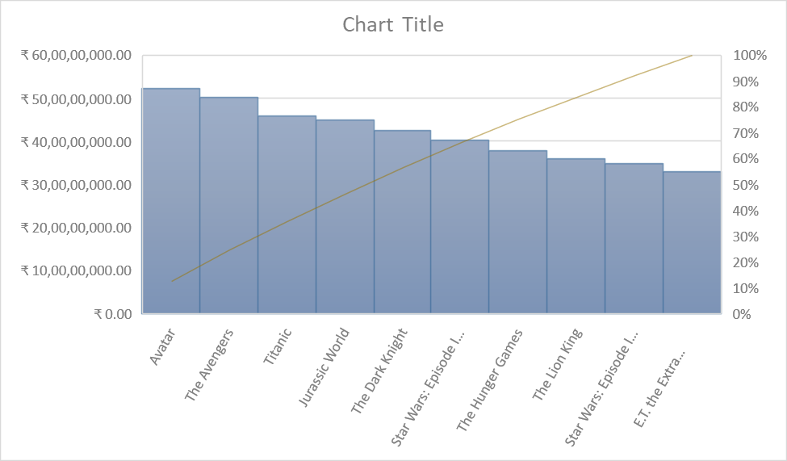
E. Budget Analysis: Explore the relationship between movie budgets and their financial success.
Task: Analyse the correlation between movie budgets and gross earnings, and identify the movies with the highest profit margin.
TOP 10 most profitable movies
There is positive correlation between budget and gross earnings as correlation coefficient value is
0.0995482
Movie with maximum profit margin is Avatar, with profit ranging over
52 crore rupees

Slide 11
Inference
Movies in Comedy, Drama, Crime/Thriller receive the highest scores from viewers
Majority of viewers would like to watch movies within the 110 – 140 minutes duration
Foreign language movies have a higher chance to attract viewers nowadays with the advent of OTTs
When it comes to directors, actors viewers still have their favourites and prefer to watch a movie more if they are a part of it
There is a small but positive relation between movie budgets and gross earnings. A movie with great CGI and VFX definitely has huge popularity but at the end of the day if the plot fails, that wouldn’t work out. So, there’s definitely a market for good storylines and intriguing plots amongst viewers even today as always.

Slide 12
Reference
Excel Workbook

Slide 13
Thank You!

